Slide 1

Toy Horse Conjoint Analysis
February 10 2020
MSMA Team 13
Tong Niu
Zhaohui Li
Yunqing Yu
Qiqi Liu
Xiao Yang
Team 13
Notes:
Niu
conjoint analysis is prediective analyss(e.g. market share predoction)

Slide 2

Executive
Summary
Recommendation:
Product
Launch products targeting at 3 different segments respectively, which correspond to
profile4($119.99/26"/Bouncing/Racing)/profile3($139.99/26"/Bouncing/Racing)
profile14($119.99/18"/Rocking/Glamour)/profile13($139.99/18"/Rocking/Glamour)
profile16($119.99/26"/Rocking/Glamour)/profile15($139.99/26"/Rocking/Glamour)
Pricing
Monitor actions of competitor, prepare different pricing strategy to the same set of products.
Promotion
Highlight “Bouncing, Racing” when promote horse toys to boys while promoting “Rocking, Glamour” to girls.
Promote 18-inch toy horse with focus on the only small size in local market.
Team 13
Notes:
Niu

Slide 3





Analytics Framework
Our Analytics Needs
Better Target Segments
Maximize Profit
Use linear regression to get individual preference on different product attributes (price,size,style,motion)
Simulate market share based on best choice conjoint model; Consider competition when computing profit
Conduct cluster analysis to find target segments
Get Partworths
Predict Missing Conjoint Data
Cluster
Analysis
A Priori
Segmentation
Market Simulation & Strategy
Predict individual ratings for profile 3/6/10/16 based on partworths
Segment on gender and age respectively, combining with cluster analysis
Team 13
Notes:
Li

Slide 4



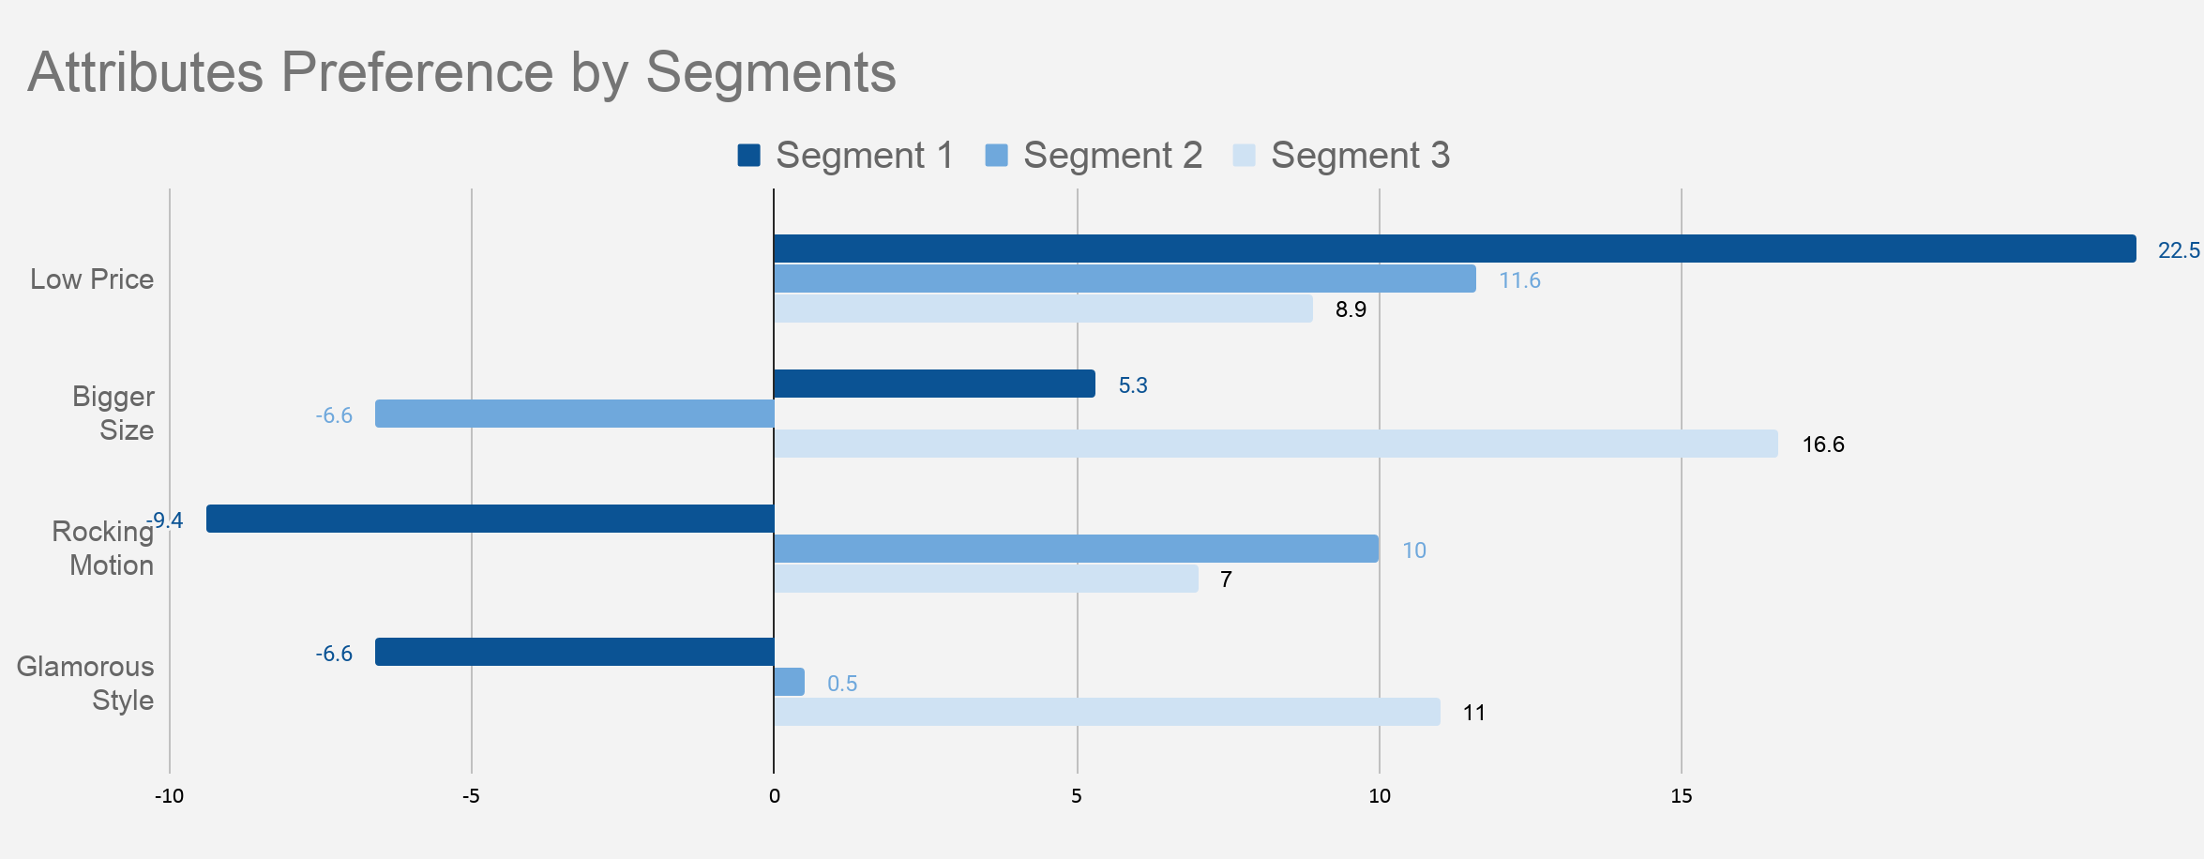
Benefit Segmentation - Cluster Analysis
profile 4
Very price sensitive; Prefer 26”, Racing, Bouncing Toy Horse
Price Radar
40%
profile 14
Price sensitive; Prefer 18”, Glamour, Rocking Toy Horse
Rock Star
26%
profile 16
Least price sensitive; Prefer 26”, Glamour, Rocking Toy Horse
Fancy Lover
34%
*See cluster analysis results in Appendix 1 and Appendix 2.
Team 13

Slide 5
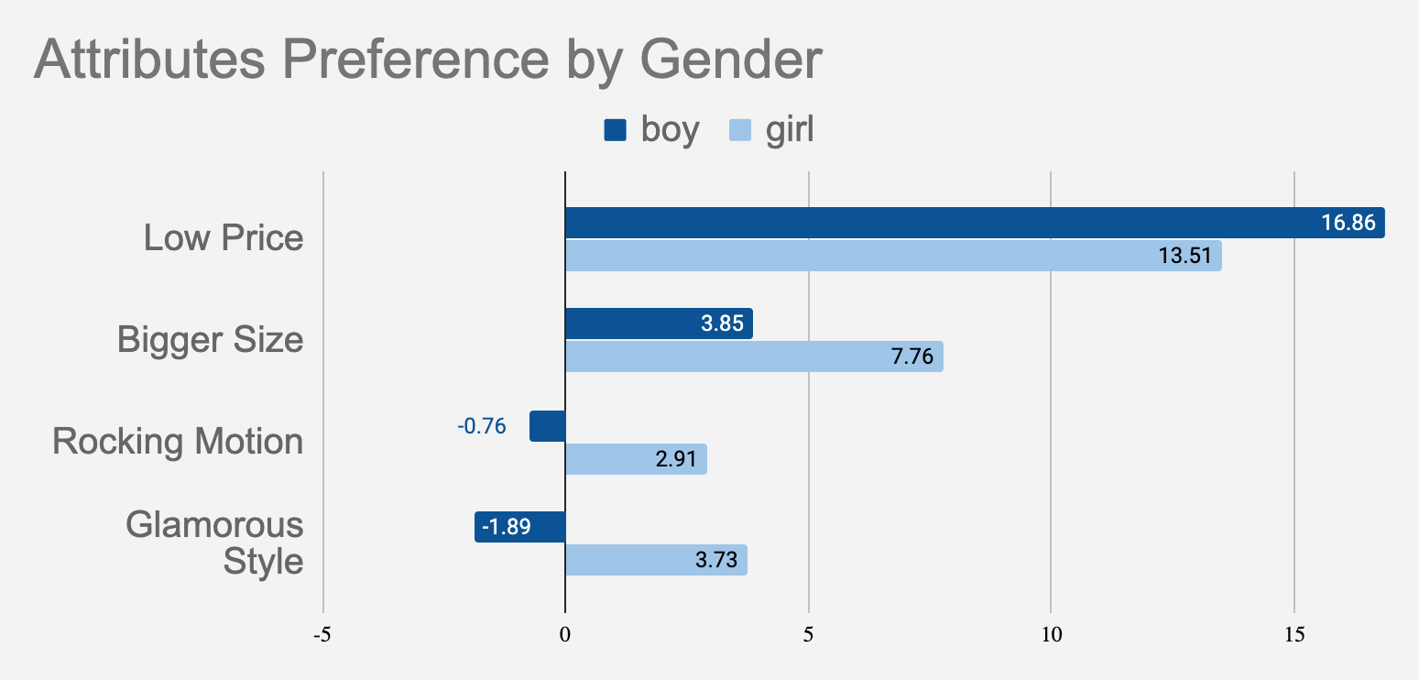
Benefit Segmentation - A Priori Segmentation
Both are price sensitive, and prefer bigger size.
They have opposite preference of motion and style:
Boys prefer Bouncing, Racing(profile4),
While girls prefer Rocking, Glamour(profile16).
Combining earlier analysis, boys share similar preference with segment 1, so boys should be targeted with profile4;
Girls share similar preference with segment 2, so girls should be targeted with profile16;
*There is no significant preference differences between younger and older kids, so we don't consider segmentation on age. (See Appendix 4)
Team 13

Slide 6
Market Simulation
$111.99 wholesale price for both competitor and EarlyRiders
Scenario | Products | Market share | Profit(EarlyRider)
Current situation | EarlyRider: $139.99/18"/Rocking/Racing (Profile 5) $139.99/18"/Rocking/Glamour (Profile 13) Competitor: $139.99/26"/Rocking/Racing (Profile 7) | EarlyRider: 22% 21% Competitor: 57% | $ 95,862.8
Scen1 | EarlyRider: $139.99/18"/Rocking/Racing (Profile 3) $139.99/18"/Rocking/Glamour (Profile 13) $139.99/18"/Rocking/Glamour (Profile 15) Competitor: $139.99/26"/Rocking/Racing (Profile 7) | EarlyRider: 38.5% 21% 34.5% Competitor: 6% | $ 218789.1
Scen2 | EarlyRider: $139.99/26"/Bouncing/Racing (Profile 3) $139.99/18"/Rocking/Glamour (Profile 15) Competitor: $139.99/26"/Rocking/Racing (Profile 7) | EarlyRider: 38.5% 44.5% Competitor: 17% | $ 200833.1
Scen3 | EarlyRider: $139.99/18"/Rocking/Glamour (Profile 3) $139.99/26"/Rocking/Glamour (Profile 13) Competitor: $139.99/26"/Rocking/Racing (Profile 7) | EarlyRider: 41.5% 31% Competitor: 27.5% | $ 189044.3
Scen4 | EarlyRider: $139.99/26"/Bouncing/Racing (Profile 13) $139.99/26"/Rocking/Glamour (Profile 15) Competitor: $139.99/26"/Rocking/Racing (Profile 7) | EarlyRider: 21% 39% Competitor: 40% | $ 130429.3
*In this case, we assume that our competitors do not drop price. Then Scen1 is our best option. We have more simulations based on different marketing reactions. See Appendix 3.
Team 13

Slide 7
Market Simulation
$95.99 wholesale price for both competitor and EarlyRiders
Scenario | Products | Market share | Profit(EarlyRider)
Current situation | EarlyRider: $139.99/18"/Rocking/Racing (Profile 5) $139.99/18"/Rocking/Glamour (Profile 13) Competitor: $139.99/26"/Rocking/Racing (Profile 7) | EarlyRider: 22% 21% Competitor: 57% | $ 95,862.8
Scen5 | EarlyRider: $119.99/18"/Rocking/Racing (Profile 4) $119.99/18"/Rocking/Glamour (Profile 14) $119.99/26"/Rocking/Glamour (Profile 16) Competitor: $119.99/26"/Rocking/Racing (Profile 8) | EarlyRider: 35.5% 22% 34% Competitor: 8.5% | $ 152010.1
Scen6 | EarlyRider: $119.99/26"/Bouncing/Racing (Profile 4) $119.99/18"/Rocking/Glamour (Profile 14) Competitor: $119.99/26"/Rocking/Racing (Profile 8) | EarlyRider: 40% 26.5% Competitor: 33.5% | $ 127286.7
Scen7 | EarlyRider: $119.99/18"/Rocking/Glamour (Profile 14) $119.99/26"/Rocking/Glamour (Profile 16) Competitor: $119.99/26"/Rocking/Racing (Profile 8) | EarlyRider: 23% 36.5% Competitor: 40.5% | $ 91569.5
Scen8 | EarlyRider: $119.99/26"/Bouncing/Racing (Profile 4) $119.99/26"/Rocking/Glamour (Profile 16) Competitor: $119.99/26"/Rocking/Racing (Profile 8) | EarlyRider: 35.5% 46.5% Competitor: 18% | $ 144073.9
*In this case, we assume our competitor has a quick response, lowering price.
Team 13

Slide 8
Toy Horse Conjoint Analysis
February 10 2020
MSMA Team 13
SIMON BUSINESS SCHOOL
Qiqi Liu : qiqi.liu@simon.rochester.edu
Xiao Yang: xiao.yang@simon.rochester.edu
Yunqing Yu: yunqing.yu@simon.rochester.edu
Tong Niu: tong.niu@simon.rochester.edu
Zhaohui Li: zhaohui.li@simon.rochester.edu
Team 13

Slide 9

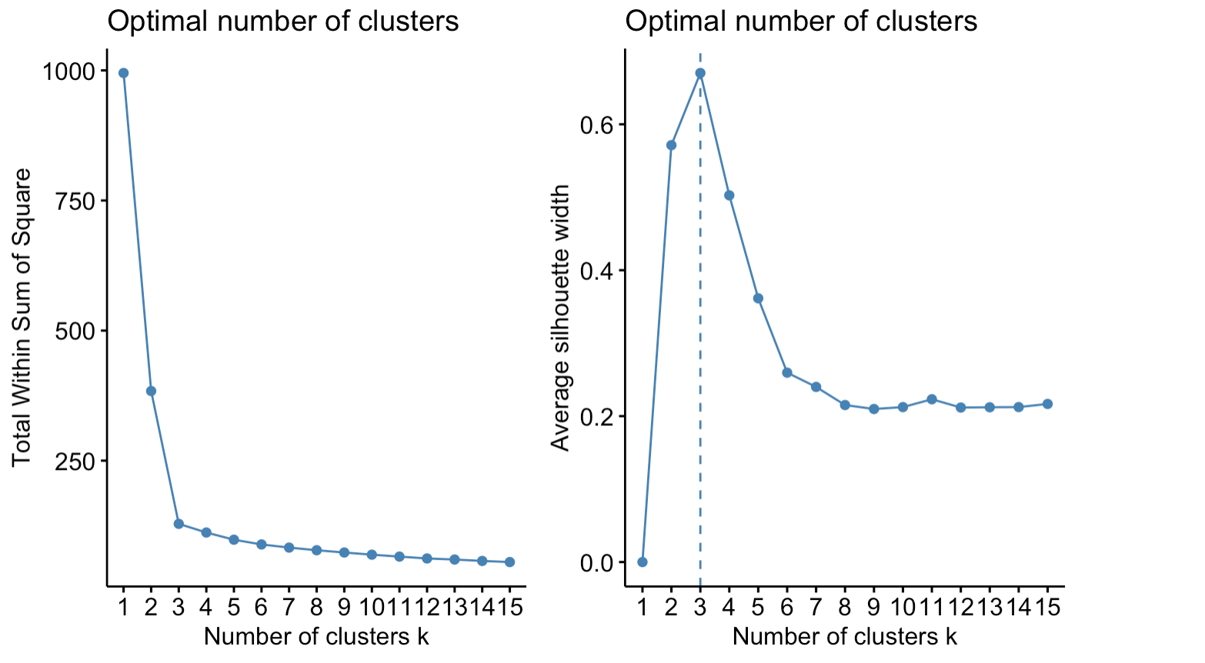
Appendix 1 - Optimal Number of Clusters
back
Team 13

Slide 10
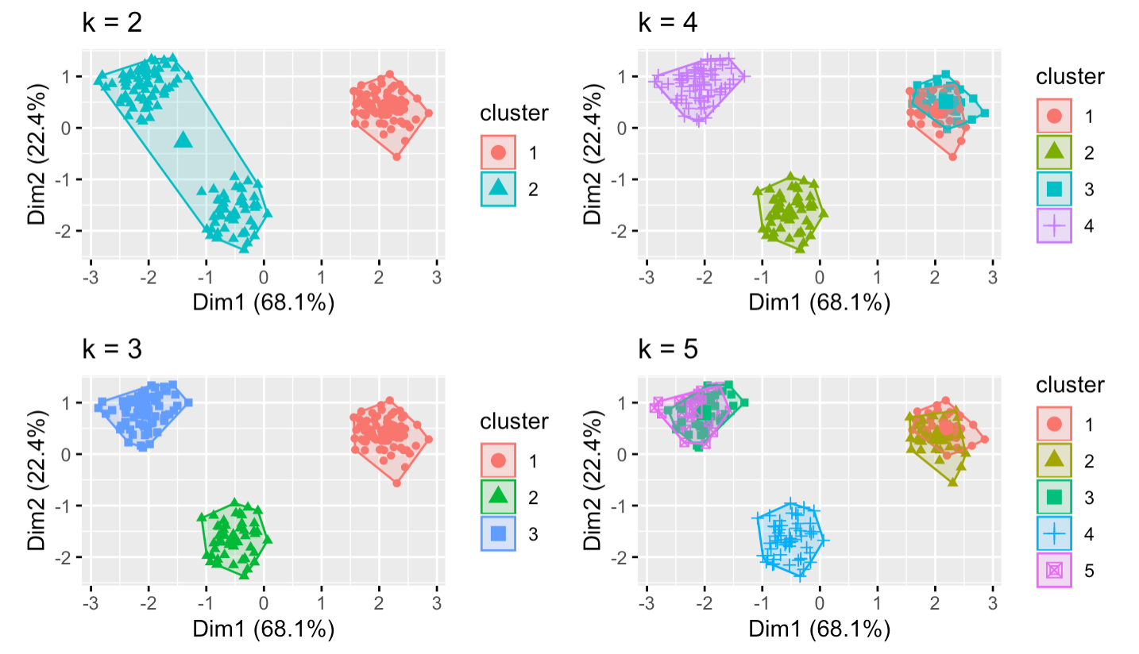
Appendix 2 - Optimal Clusters
back
Team 13

Slide 11
Appendix 3 - Prisoners Dilemma
EarlyRiders
high
low
-2962.4, 218789.1 (7, 3,13,15) | -12901, 208594.3 (7, 14,15)
23992, 140714.7 (8, 4,14,15) | -1303.4, 152010.1 (8, 4,14,16)
high
competitor
low
back to market simulation
Team 13
Notes:
price match guaranteee

Slide 12
Appendix 3 - Market Simulation
$111.99 for both competitor and EarlyRiders
Profile3,13,15 is our best option to maximize profit
status quo(7, 5,13): our profit: 95862.8, competitor profit: 141857.2
scenario | profile7 | profile3 | profile13 | profile15 | profit | profitCompet
1 | 0.06 | 0.385 | 0.21 | 0.345 | 218789.066666667 | -2962.4
2 | 0.17 | 0.385 |  | 0.445 | 200833.466666667 | 28273.2
3 | 0.275 | 0.415 | 0.31 |  | 189044.333333333 | 58089
4 | 0.4 |  | 0.21 | 0.39 | 130429.333333333 | 93584
Assumptions:
When there is a tie in the first choice, we split the possibility equally.
Competitors' cost structures are the same with ours.
Competitors all have the same move.
Only allow one product line change per year.
There is no cost for dropping products.
Only allow price change once.
back to market simulation
Team 13

Slide 13
Appendix 3 - Market Simulation
We drop price and they don't respond, profile14,15 is our best option to maximize profit
scenario | profile7 | profile3 | profile4 | profile13 | profile14 | profile15 | profile16 | profit | profitCompet
21 | 0.095 |  | 0.52 |  |  | 0.385 |  | 195330.466666667 | 6976.2
22 | 0.005 | 0.035 |  |  |  |  | 0.96 | 169446.866666667 | -18580.2
23 | 0 |  | 0.405 |  |  |  | 0.595 | 186066.666666667 | -20000
24 | 0.145 |  | 0.65 | 0.205 |  |  |  | 192279.133333333 | 21174.2
25 | 0.09 | 0.185 |  |  | 0.725 |  |  | 197416.933333333 | 5556.4
26 | 0.055 |  | 0.52 |  | 0.425 |  |  | 199755.533333333 | -4382.2
27 | 0.025 |  |  |  | 0.675 | 0.3 |  | 208594.333333333 | -12901
28 | 0.005 |  |  | 0.05 |  |  | 0.945 | 176993.533333333 | -18580.2
29 | 0.005 |  |  |  | 0.3 |  | 0.695 | 181793.533333333 | -18580.2
30 | 0.03 |  | 0.48 | 0.18 |  | 0.31 |  | 200187.866666667 | -11481.2
31 | 0.02 | 0.18 |  |  | 0.5 | 0.3 |  | 197587.466666667 | -14320.8
32 | 0.005 | 0.035 |  | 0.05 |  |  | 0.91 | 154246.866666667 | -18580.2
33 | 0.01 |  | 0.435 |  | 0.28 | 0.275 |  | 191867.066666667 | -17160.4
34 | 0 |  | 0.405 | 0.05 |  |  | 0.545 | 170866.666666667 | -20000
35 | 0.005 | 0.035 |  |  | 0.3 |  | 0.66 | 159046.866666667 | -18580.2
36 | 0 |  | 0.4 |  | 0.25 |  | 0.35 | 173826.666666667 | -20000
back to market simulation
Team 13

Slide 14
Appendix 3 - Market Simulation
$95.99 for both competitor and EarlyRiders, 4,14,16 is best option
scenario | profile8 | profile4 | profile14 | profile16 | profit | profitCompet
37 | 0.085 | 0.355 | 0.22 | 0.34 | 152010.066666667 | -1303.4
38 | 0.335 | 0.4 | 0.265 |  | 127286.733333333 | 53686.6
39 | 0.405 |  | 0.23 | 0.365 | 91569.5333333333 | 69083.8
40 | 0.18 | 0.355 |  | 0.465 | 144073.866666667 | 19592.8
back to market simulation
Team 13

Slide 15
Appendix 3 - Market Simulation
Competitors drop price, we respond with lowering some of prices, 4,14,15 is best option
scenario | profile8 | profile3 | profile4 | profile13 | profile14 | profile15 | profile16 | profit | profitCompet
5 | 0.71 | 0.005 |  | 0.065 |  | 0.22 |  | 11335.0666666667 | 136171.6
6 | 0.77 | 0.005 |  |  |  | 0.225 |  | 12217.4666666667 | 149369.2
7 | 0.93 | 0.005 |  | 0.065 |  |  |  | -24469.4666666667 | 184562.8
8 | 0.715 |  |  | 0.065 |  | 0.22 |  | 36341.9333333333 | 137271.4
9 | 0.345 |  | 0.375 | 0.065 |  | 0.215 |  | 108740.466666667 | 55886.2
10 | 0.545 | 0 |  |  | 0.245 | 0.21 |  | 48028.4666666667 | 99878.2
11 | 0.495 | 0 |  | 0.035 |  |  | 0.47 | 41106.4666666667 | 88880.2
12 | 0.405 | 0 |  |  | 0.23 |  | 0.365 | 64902.8666666667 | 69083.8
13 | 0.17 |  | 0.355 | 0.035 |  |  | 0.44 | 129633.466666667 | 17393.2
14 | 0.2 |  | 0.37 |  | 0.225 | 0.205 |  | 140714.666666667 | 23992
15 | 0.405 |  | 0.375 |  |  | 0.22 |  | 109622.866666667 | 69083.8
16 | 0.505 | 0 |  |  |  |  | 0.495 | 55546.8666666667 | 91079.8
17 | 0.52 |  | 0.415 | 0.065 |  |  |  | 85074.1333333333 | 94379.2
18 | 0.7 | 0 |  |  | 0.3 |  |  | 28921.3333333333 | 133972
19 | 0.495 |  |  | 0.035 |  |  | 0.47 | 67773.1333333333 | 88880.2
20 | 0.545 |  |  |  | 0.245 | 0.21 |  | 74695.1333333333 | 99878.2
back to market simulation
Team 13

Slide 16
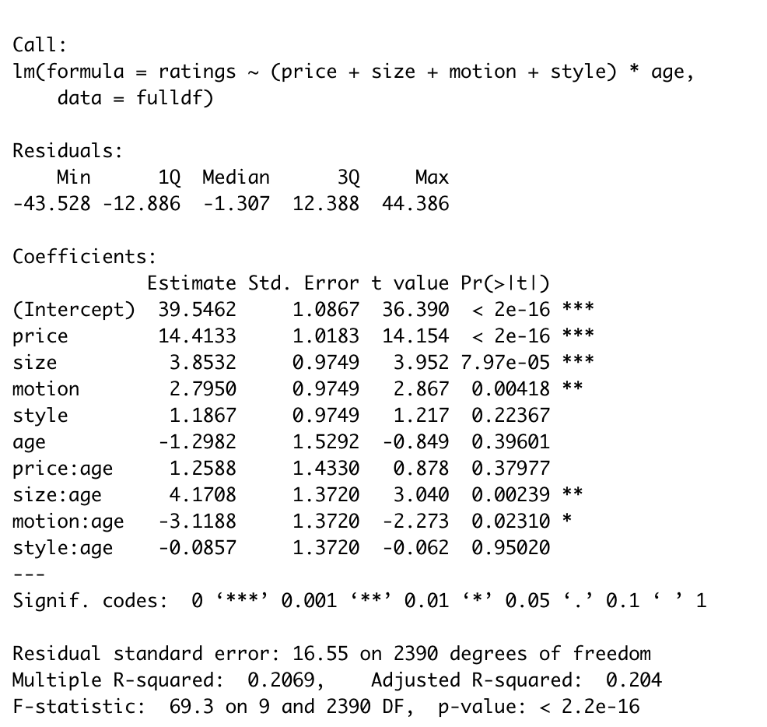
Appendix 4 - Statistic Test
p-value > 5%, therefore reject the null hypothesis.
back
Team 13

